Slide 1
複製與領導的力量
Duplication and Leadership
Katherine Yin
副總裁級
Field Vice President
四個佣金週期共賺取HK$276,000
HK$276,000 in 4 Commission weeks
本簡報中提到的收入等級純屬舉例說明，無意代表美安香港超連鎖™店主的一般收入，也無意表示任何超連鎖™店主皆可賺取同等收入。美安香港超連鎖™店主的成功與否，取決於其在發展事業時的努力、才能與投入程度。
The income levels mentioned in the following presentation are for illustration purposes only. They are not intended to represent the income of a typical Market Hong Kong UnFranchise ™Owner, nor are they intended to represent that any given Independent UnFranchise ™ Owner will earn income in that amount. The success of any Market Hong Kong Independent UnFranchise ™ Owner will depend upon the amount of hard work, talent, and dedication which he or she devotes to building his or her Market Hong Kong Business.

Slide 2
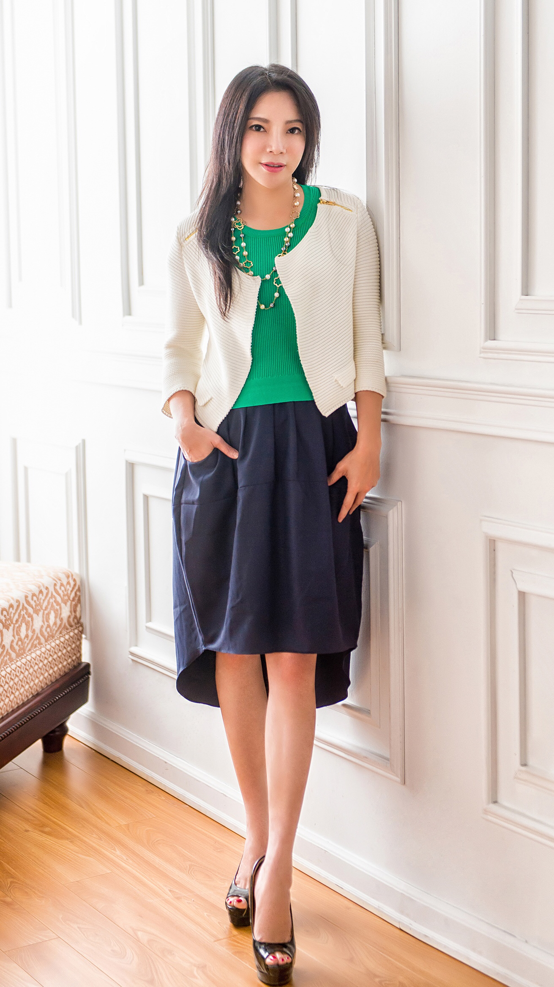
Katherine Yin
Field Vice President
＄36,000-$45,000 USD/4 wks
Graduated from Fu Jen Catholic University
IT master degree (U.S.)
Member of Million Dollar Club
Member of Speaker Bureau
Member of Market America Advisory Council

Slide 3
DUPLICATION
&
LEADERSHIP

Slide 4
Duplication
Duplication - WHY？
Duplication - WHAT？

Slide 5
What to duplicate?
Business opportunity
Invitation
MPCP
Follow up (Questions)
Pace of development
Learning attitude
Emotional control

Slide 6
Emotion
Emotion
Sign-up
Chat with senior partners
B5
Return accepted by corporate
1st Invitation being rejected
Delivery issue
Only 179 softgels in Omega III
2nd Invitation being rejected
Problem

Slide 7
Emotion
Emotion
Understand Administrative Regulations
Attend Convention and recharge
Future Director
Chat with senior partners
Sign-up
Ｂ5
Not supported by friends and families
2nd Invitation being rejected
1st Invitation being rejected
Product arrived but one OPC is missing
Forgot ordering UFMS
BV/IBV flushed
Problem

Slide 8
LEADERSHIP

Slide 9
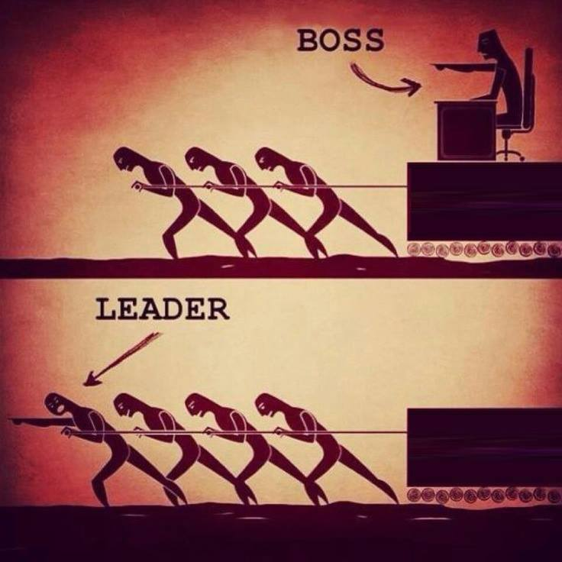

Slide 10
Leadership
Leadership ＃ Power ＝ Influence
Ability to communicate
Ability to tolerate
Ability to inspire
Responsibility
Follow through with commitment

